Slide 1
CTEC 298-individual presentation
Saiquan Jamison
Dr. Bemley

Slide 2
CTEC 128- SUMMARY
Was a Big Data class, Big Data is a term that describes the large volume of data - both structured and unstructured- that inudates a business on a day-to-day basis. But it's not the amount of data that's important. It's what organizations do with the data that matters. Big data can be analyzed for insights that lead to better decisions and strategic business moves. Big Data has traditionally been characterized by 3 Big Vs-Volume, Velocity and Variety.
Volume. Organizations collect data from a variety of sources, including business transactions, social media and information from sensor or machine-to-machine data. In the past, storing it would’ve been a problem – but new technologies (such as Hadoop) have eased the burden.
Velocity. Data streams in at an unprecedented speed and must be dealt with in a timely manner. RFID tags, sensors and smart metering are driving the need to deal with torrents of data in near-real time.
Variety. Data comes in all types of formats – from structured, numeric data in traditional databases to unstructured text documents, email, video, audio, stock ticker data and financial transactions.
Learned the basic principles of Data Science(Problem solving, Data analytic thinking, Data mining, Visualization)\
Ethical Concerns Data Scientist should consider( Preserving privacy, Research bias, Societal value of data, Dat sensitivity)
Steps of Data Science Process( Formation of the data science team, develop a business understanding, Get the data, Exploratory data analysis, Communicate results, make recommendations.)
Six Steps of the Problem-Definition Process( Understand the Situation, Identify the Problem, Establish Research Objectives, Determine Unit of Analysis, Determine Relevant Variables, Write Research Questions.)

Slide 3
CTEC 298
Dataquest was the first online assignment we were assigned tutorial Data Analyst will be used to develop python data science fundamentals. The Tableau tutorial will be used to develop visualizations using commercial software. Various open source python libraries tutorials will be used to solve problems such as numpy, matplotlib, pandas and environments such as anaconda and tensorflow.
Anaconda is a free and open-source distribution of the Python and R programming languages for scientific computing (data science, machine learning applications, large-scale data processing, predictive analytics, etc.) , that aims to simplify package management and deployment.
The Jupyter Notebook is an open-source web application that allows you to create and share documents that contain live code, equations, visualizations and narrative text.Uses include: data cleaning and transformation, numerical simulation, statistical modeling, data visualization, machine learning, and much more.
GitHub is a code hosting platform for version control and collaboration. It lets you and others work together on projects from anywhere. A repository is usually used to organize a single project. Repositories can contain folders and files, images, videos, spreadsheets, and data sets.Branching is the way to work on different versions of a repository at one time.Pull Requests are the heart of collaboration on GitHub. When you open a pull request, you’re proposing your changes and requesting that someone review and pull in your contribution and merge them into their branch. Pull requests show diffs, or differences, of the content from both branches. The changes, additions, and subtractions are shown in green and red.
Matplotlib is a Python 2D plotting library which produces publication quality figures in a variety of hard copy formats and interactive environments across platforms. Matplotlib can be used in Python scripts, the Python and IPython shells, the Jupyter notebook, web application servers, and four graphical user interface toolkits.
pandas is an open source, BSD-licensed library providing high-performance, easy-to-use data structures and data analysis tools for the Python programming language.
pandas is a NumFOCUS sponsored project. This will help ensure the success of development of pandas as a world-class open-source project, and makes it possible to donate to the project.

Slide 4
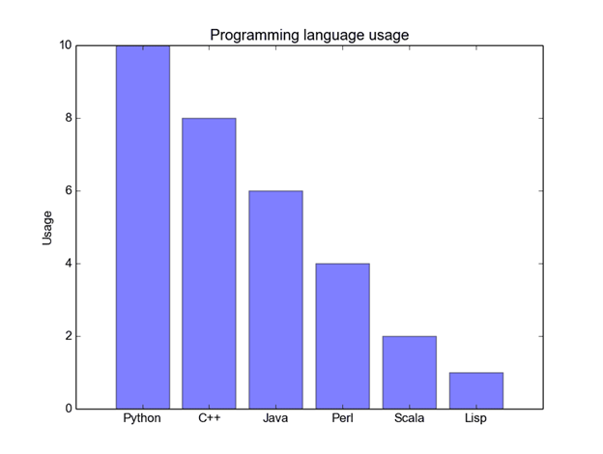
Graph Analysis-BAR GRAPH
CODE:
import matplotlib.pyplot as plt; plt.rcdefaults()
import numpy as np
import matplotlib.pyplot as plt
objects = ('Python', 'C++', 'Java', 'Perl', 'Scala', 'Lisp')
y_pos = np.arange(len(objects))
performance = [10,8,6,4,2,1]
plt.bar(y_pos, performance, align='center', alpha=0.5)
plt.xticks(y_pos, objects)
plt.ylabel('Usage')
plt.title('Programming language usage')
plt.show()

Slide 5
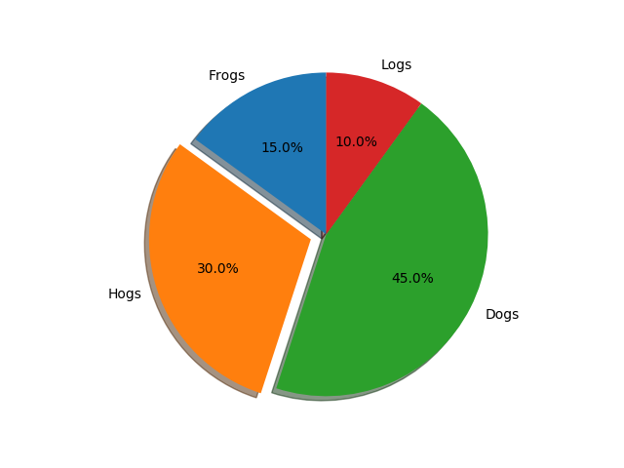
GRaph analysis- pie plot
import matplotlib.pyplot as plt
labels = 'Frogs', 'Hogs', 'Dogs', 'Logs'
sizes = [15, 30, 45, 10]
explode = (0, 0.1, 0, 0) # only "explode" the 2nd slice (i.e. 'Hogs')
ig1, ax1 = plt.subplots()
ax1.pie(sizes, explode=explode, labels=labels, autopct='%1.1f%%',
shadow=True, startangle=90)
ax1.axis('equal') # Equal aspect ratio ensures that pie is drawn as a circle.
plt.show()

Slide 6
Conclusion
This class was pretty much a more depth and informing Data class and helped me learn different aspects of plotting and coding through python. This course is an introduction to symbolic computations using Mathematical software packages such as Mathematica, Matlab and Maple. Symbolic computation deals with the computation of mathematical objects symbolically. The mathematical objects are represented exactly, not approximately, and mathematical expressions with unevaluated variables are left in symbolic form. This class was very informative to me and i believe everyone in my class learned something different every class, that we did not know.

